Slide 1

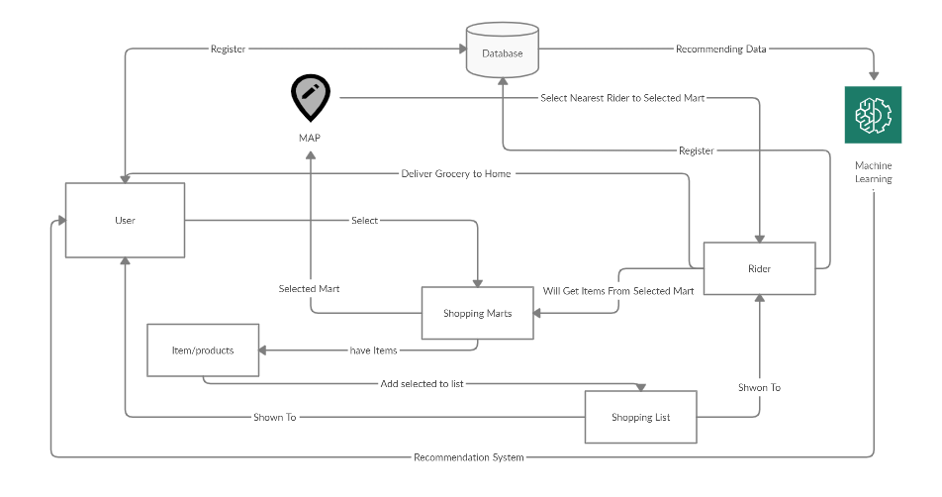
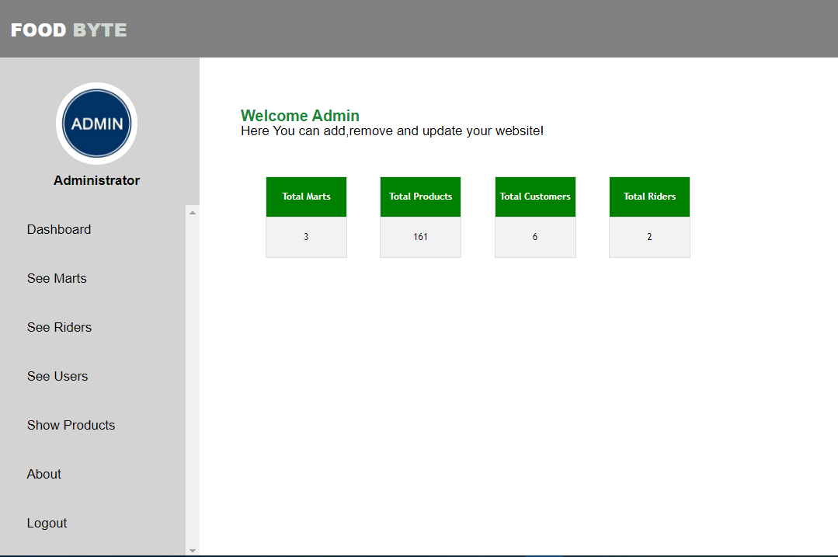
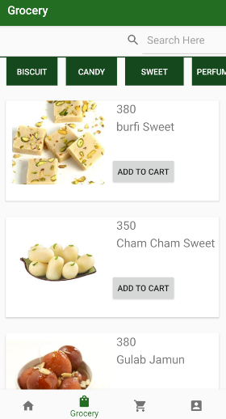
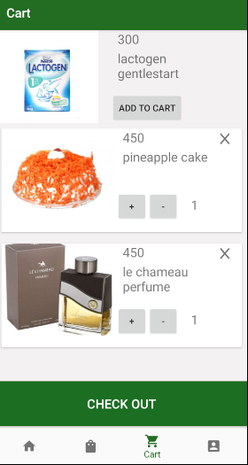

^{FOOD BYTE} ^{Final Year Project (2017-2021)} ^{Department of Computer Science} COMSATS University Islamabad, Attock Campus
Introduction
FoodByte is a grocery shopping android app and web (Portal) App where user can buy grocery items online. The purpose of this system is to give benefit and ease to user by saving their precious time. Through this app and website user will be able to get all grocery items on their door step without going to supermarket with carrying heavy bags and waiting in queue outside the shop for your turn. Secondly it will give an opportunity of earning for those riders who will go to supermarket instead of you and also it will be an advertisement platform for the marts that will register themselves on our app.
Motivations
Save Time and efficiency
Providing rider service.
Earning Opportunity.
Ease to find products and ordering.
No need of carrying heavy bags and waiting in queue outside the shop for your turn.
System Background
There are some problems with the existing systems which are identified below:
They are for a single mart.
No middle man.
For specific items.
Architecture
Results
Admin Page
To manage the marts, users and riders.
Conclusion
In this project, we developed an Android and web-based application for android device. It features a series of Cards (Modules) for the users, where users can view the grocery items available on different marts. Users can buy products from different marts.it helps people to do grocery shopping without physical effort. Rider will bring their required order at their doorsteps
User Application
Browse menu and order the food.
Future Directions
Adding more marts and more products other than grocery items.
Adding toys related items for grasping the attention of children.
Adding feedback Module to get reviews from Users.
Objectives
Providing an interactive digital Interface.
Getting customers’ loyalty and attraction.
Order made to the registered shopkeepers.
Machine learning Algorithm for recommendations.
Nearest rider selection.
Earning Opportunity.
Group Members
Muhammad Bilal
mbilal22232@gmail.com
Muhammad Afshal
mirzaafshal@gmail.com
Supervisor: Ma'am Tahira Sadaf

